Slide 1
Welcome to Philosophy Session 2 Ancient Philosophers
Tutors: Jake Dorothy and Sarah Quinn

Slide 2
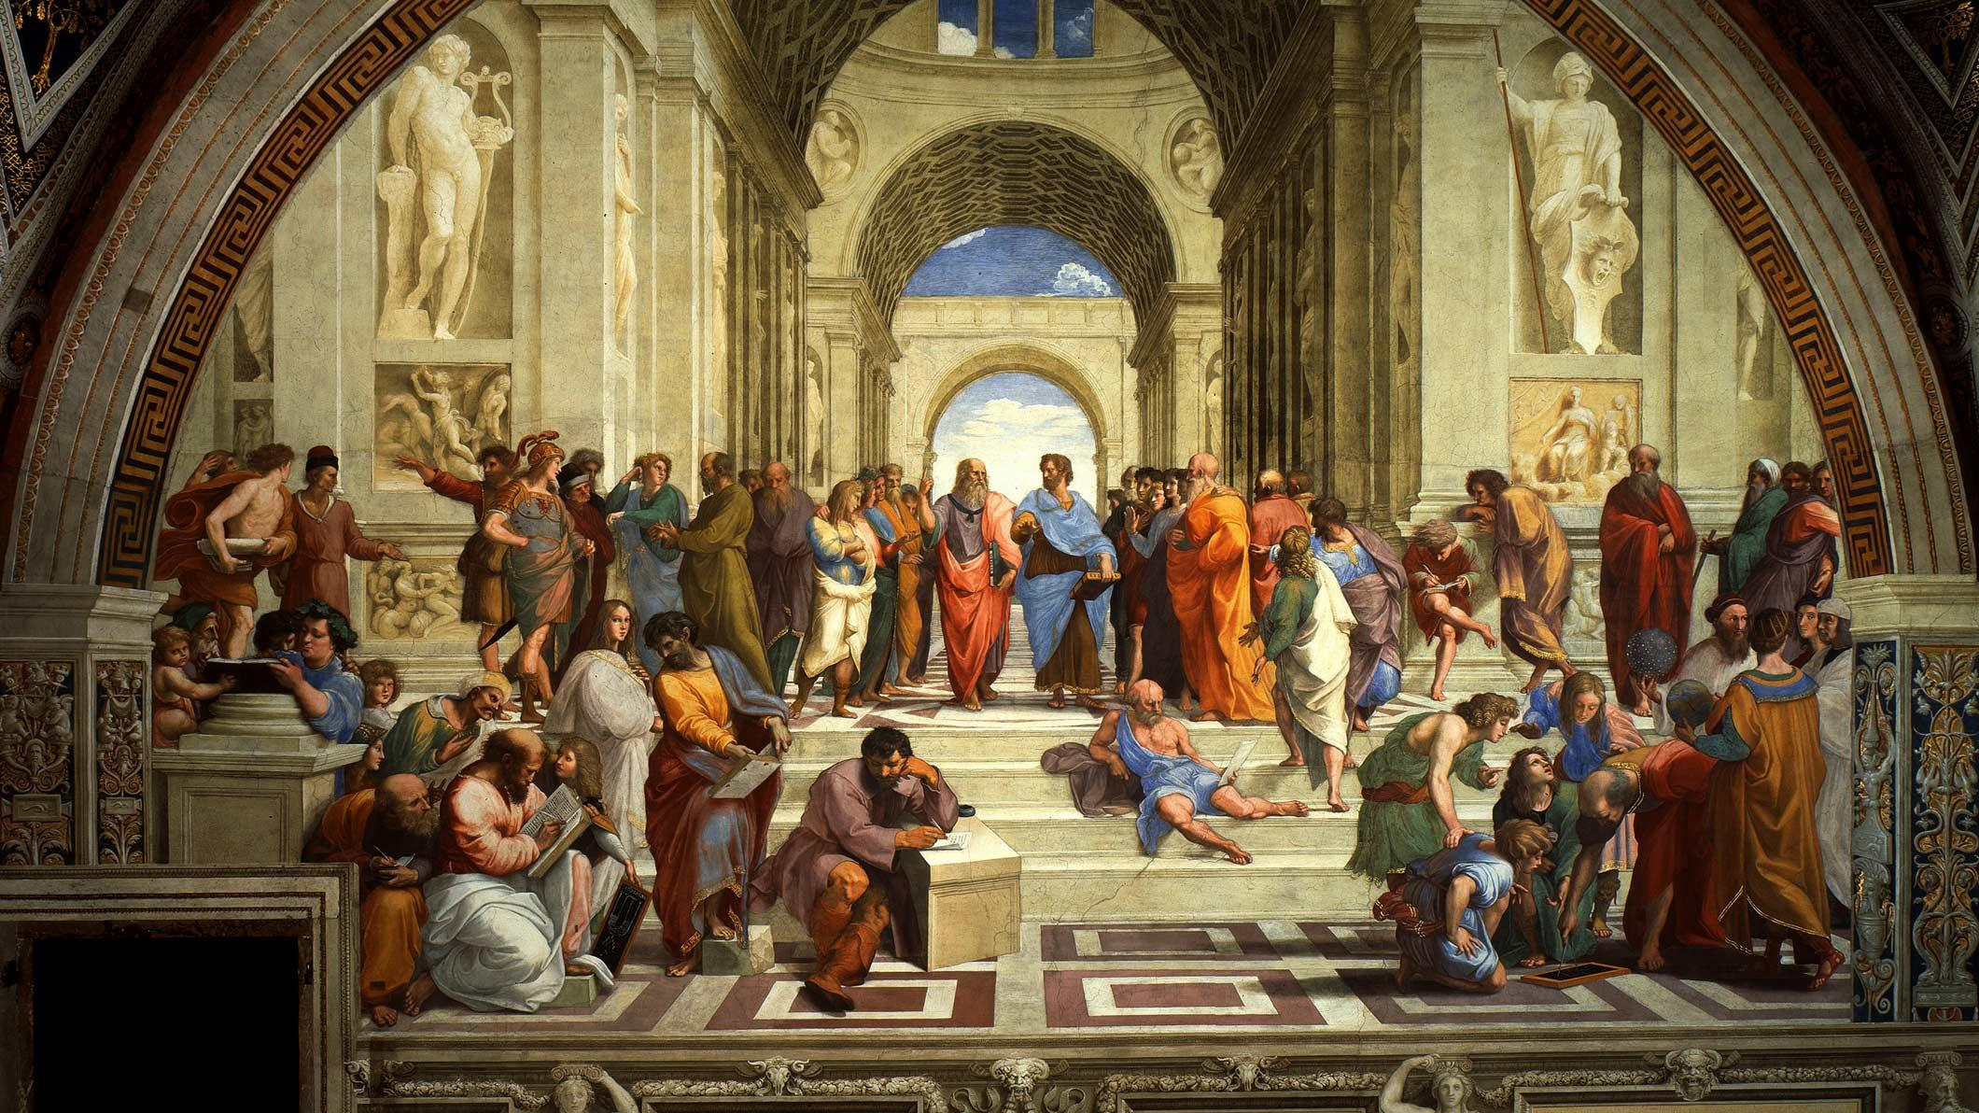
Introduction to Plato and Aristotle
The School of Athens by Raphael, 1511 A.D.
Plato (centre left), 428 B.C. – 348 B.C. (80 years)
Aristotle (centre right), 384 B.C. – 322 B.C. (62 years)

Slide 3
Plato’s Rationalism
Rationalism: the view that all knowledge starts with the mind.
Knowledge: objective facts that are unchanging.
All knowledge comes from truths we get by using our reason.
Some knowledge is innate (originates in the mind) e.g., numerical reasoning, such as facts about triangles.
All the knowledge we have creates one great deductive system – we can use our reason to uncover more truths from truths that we already know.
Our opinions are sensory claims which are subject to bias, corruption and debate. They are inferior to knowledge.

Slide 4
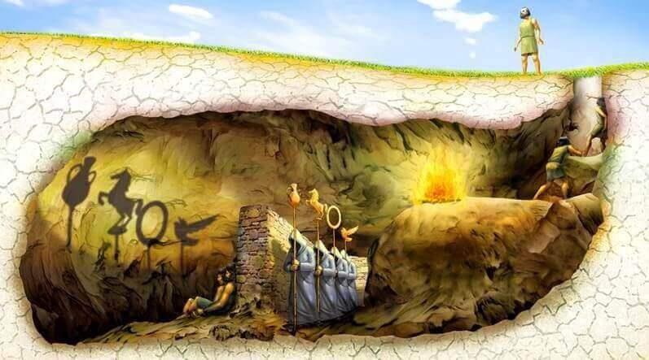
Plato and The Theory of Forms
Cave Analogy

Slide 5
Plato and The Theory of Forms
The Cave Analogy Explained
Two worlds – visible world and intelligible world
We live in the visible world
Visible world = inside the cave, chained-up prisoners, shadows, puppets, puppeteers
Visible world = a society that is ignorant of the fact that some people manipulate their beliefs, we are fooled by our senses and experiences, we cannot get knowledge from our experiences in this world
Intelligible world = outside the cave, reflections, ‘real’ objects, the sun
Intelligible world = a world of Forms, of truth and knowledge, these are in a hierarchy (inanimate objects, living objects, ideals and concepts, universal qualities, the Good)
The freed prisoner represents a philosopher who by using reason can journey from ignorance to enlightenment

Slide 6
Plato and The Theory of Forms
For every imperfect object and quality that exists in the visible world, there exists a perfect Form of it in the intelligible world.
These Forms are what makes a thing what it is – all chairs, even though they are all so different and have varying properties, get their ‘chairness’ from the Form of a chair, which is perfect, objective, unchanging and universal.
These Forms can be used as standards of measurement – we can judge how straight a line is by comparing it to the Form of straightness. All lines partake in the Form of straightness to lesser and greater extents.
Truth and reality are found in the world of Forms, not in the physical world.

Slide 7
Plato and The Theory of Forms
Metaphor of The Sun
The sun = the Form of the Good
Just as our eyes need light to see, our minds need the Form of the Good to see because it ‘illuminates’ the other forms. It shows that the Forms are good because they are true, unchanging and eternal.
If we can understand the Form of the Good, we can understand the value of all things. Any good act that we carry out in this world is an imitation of the Good.

Slide 8
Plato and The Theory of Forms
Some Counter Arguments
Any ideas?

Slide 9
Plato and The Theory of Forms
Some Counter Arguments
Surely Plato needs a Form of Forms to explain what the Forms have in common, and then a Form of Forms and so on, creating an infinite regress of Forms.
The existence of a realm of Forms may not be an obvious conclusion of reasoning.
Can we really understand the Form of the Good? Two equally intelligent people may disagree on whether mathematics is good, or a waste of time. How can we tell who is right?
Plato’s possible responses?

Slide 10
Plato’s Eudaimonia
Eudaimonia (‘extreme happiness’) = understanding the highest Form of the Good
There is only one good, one single, universal entity of goodness.
What does that mean for us? We can reach eudaimonia through reasoning, and using our minds to come to understand truths.
Does this sound like the right account of extreme happiness?

Slide 11
10 minute break

Slide 12
Aristotle’s Empiricism
Aristotle was an empiricist.
Empiricism: the view that all knowledge starts with the senses.
All knowledge comes from truths we get from experience.
No knowledge is innate (ideas/concepts that originate in the mind).
Knowledge is acquired through observations, the more you observe, the more knowledge you gain.
Knowledge gained through reason is wrong unless it can be traced back to experience.
More scientific and practical, less idealistic.

Slide 13
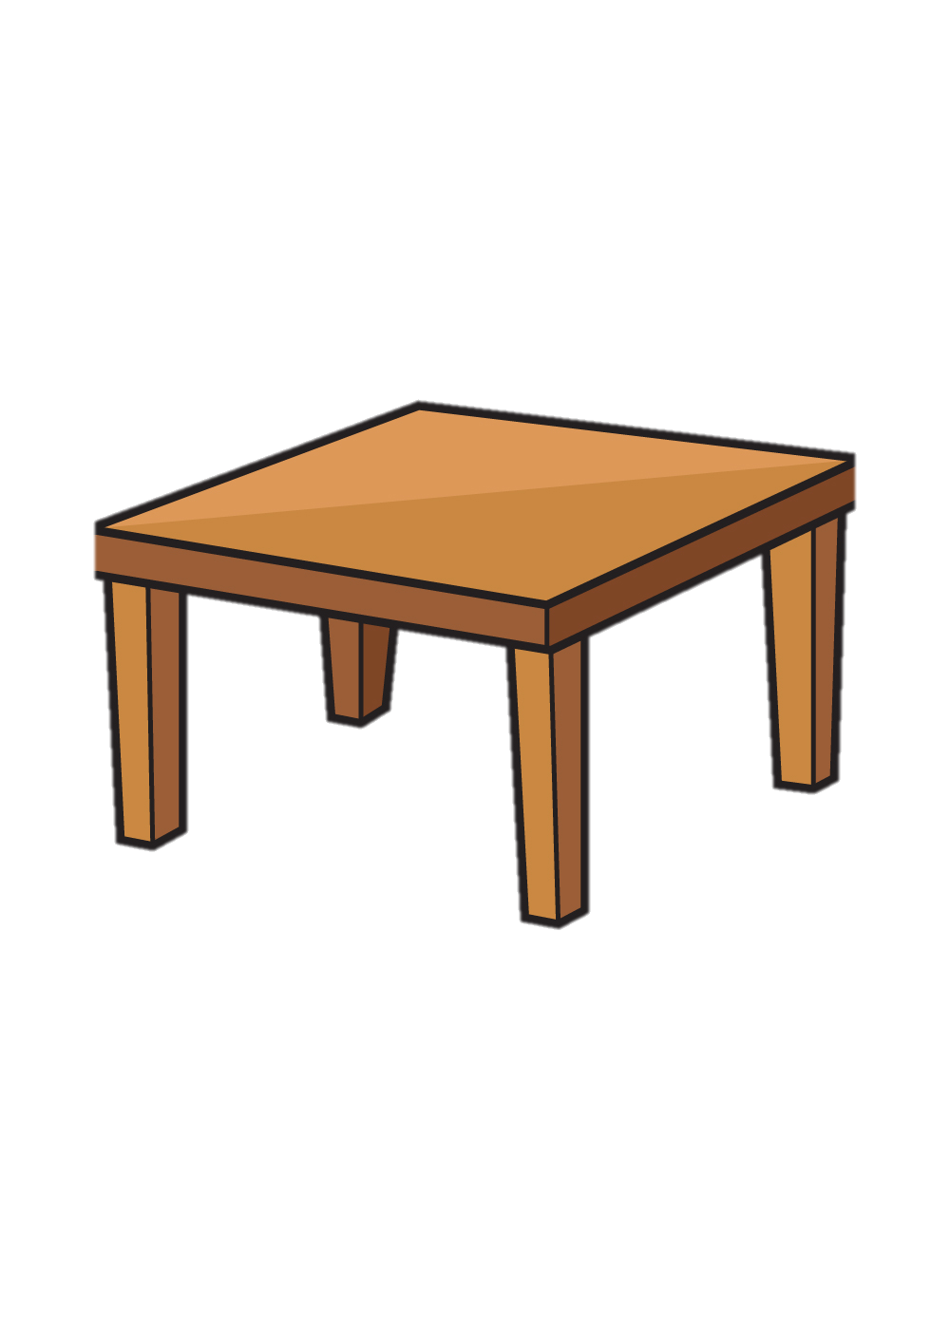
Aristotle’s Four Causes
Aristotle’s four causes explain why a thing exists as it does. It is his theory for understanding the truth about everything around us. To understand the truth of our world, we have to know the four causes of every object.
1. Material cause
The substance that something is made of, e.g., book – paper, table – wood
2. Efficient cause
The cause of a thing existing, e.g., book – writer, table – carpenter
3. Formal cause
The cause of a thing’s form/structure, e.g., book – covers and pages, table – legs and surface
4. Final cause
The cause of a thing’s function/purpose, e.g., book – being read, table – support the weight of other objects
It is the ultimate reason for existence

Slide 14
Aristotle’s Final Cause
Aristotle said that an objects’ final cause has nothing to do with human desires. For example, the final cause of a hammer is to hammer nails, even if a human never wanted to use it to do so.
Artistotle wanted his theory to apply to objects both in the artificial world (books, tables) and in the natural world (flowers, swans).

Slide 15
Aristotle’s Eudaimona
Eudaimonia (‘extreme happiness’) = flourishing
Achieve it by achieving your final cause (purpose)
Not one entity, every thing has a different purpose, e.g., books, tables, swans, people
What does this mean for us? Aristotle used a very biological approach to conclude that like other animals, we will flourish if we grow and are healthy and repopulate. Specifically to humans though, we will flourish if we are rational and social.

Slide 16
Aristotle’s Four Causes and Eudaimonia
Some Counter Arguments
Any ideas?

Slide 17
Aristotle’s Four Causes and Eudaimonia
Some Counter Arguments
Some philosophers say that we cannot argue that the universe has a purpose, or that anything in it does either.
It is one thing for humans to decide what the final cause of other things is, but we have no independent agent to decide what the final cause of humans is.
Aristotle’s possible responses?

Slide 18
Plato vs. Aristotle
Rationalism vs. Empiricism
What is knowledge?
Plato
We get it by using our reason
Some knowledge is innate
Intelligible world of Forms = true reality, we use them to get knowledge
Aristotle
We get it by making observations
No knowledge is innate
Physical world = true reality, we can use it to get knowledge

Slide 19
Plato vs. Aristotle
Eudaimona
What is extreme happiness?
Plato – the highest Form of the Good, which we reach through reasoning and trying to understand the Forms
Aristotle – the final cause, which we reach through being good rational and social animals

Slide 20
Summary
Plato’s rationalism and Aristotle’s empiricism
Plato’s theory of forms
Aristotle’s four causes
Eudaimonia

