Slide 1
Welcome to Philosophy Session 4 Ethics
Tutors: Jake Dorothy and Sarah Quinn

Slide 2
Introduction to Ethics
Ethics = the practise analysing concepts of right and wrong actions.
Ethical theories attempt to provide answers to what are right and wrong actions.
Theories we will look at:
Utilitarianism – Jeremy Bentham and John Stewart Mill
Kantianism – Immanuel Kant
Virtue ethics - Aristotle

Slide 3
Utilitarianism - Bentham
Act utilitarianism
A good act = one that creates the greatest amount of pleasure for the greatest number of people, and the least amount of pain for the greatest number of people.
“Man has been placed under two sovereign masters, pain and pleasure. It is for them alone to point out what we ought to do”.
Actions are judged as a means to an end.
He created a hedonic calculus to quantify how good an action is. It has six criteria:
Duration – how long it will last for
Intensity – how much pleasure, to what extent
Remoteness – how certain is it
Richness – will it lead to further pleasure
Purity – how free from pain is it
Extent – how wide are its effects
Example: eating a chocolate bar

Slide 4
Utilitarianism - Mill
Rule utilitarianism
Agreed that the goodness of an action should be based on how much pleasure and how little pain there is in its consequence.
Didn’t think that quantity was enough. Added quality.
Mill argued that there needs to be rules for people to follow that generally lead to the greatest good for the greatest number. Society is better when people follow laws and customs aimed at making everyone happier, instead of everyone calculating each action individually.
Example of rules: do not lie, seek higher pleasures over lower pleasures.
Higher pleasures: from using our minds, e.g., reading or debating
Lower pleasures: from using our bodies, e.g., eating chocolate or swimming

Slide 5
Utilitarianism Thought Experiments
Trolley problem
Trolley problem continued
Surgeon problem

Slide 6
Utilitarianism – Bentham and Mill
Pros and cons?

Slide 7
10 minute break

Slide 8
Kantian Ethics - Kant
A good act = one that is dutiful.
Duty: not personal interest, not to gain anything, but to act in accordance with reason.
A good/ dutiful action is universal, and unconditional. They apply to everyone equally.
A good act is an end in itself, not a means to an end. This means that a person acts morally for the sake of it being the right thing to do, not to gain anything.
Categorical imperative: ‘Do x’ (or ‘Do not do x’), e.g., tell the truth, treat people with respect. Categorical imperatives are what we need to focus on for working out if an action is good.
Universalizability principle: Act in accordance with rules that you would wish to be universal law. If everyone in the world did ‘x’, then would it be good? Example: theft
Humanity principle: never treat people as a mere means to an end. Treat them as a means in themselves and respect their autonomy. Example: deceiving someone

Slide 9
Kant Thought Experiments
Murderer at the door

Slide 10
Kantian Ethics
Pros and cons?

Slide 11
Virtue Ethics
Originates form Aristotle
Unlike utilitarianism and Kantian ethics, which look at what is a good action, virtue ethics looks at what is a good life and a good person. If we are good people, then good actions will follow.
Good = virtuous.
Aristotle said a virtuous person has ideal character traits: courage, generosity, ambition, patience, friendliness, truthfulness, wit, modesty, justice. Someone with these character traits will be predictably virtuous.
Aristotle believes that we are born with a desire to be virtuous, but we are born with both positive and negative character traits, called vices, such as cowardice and recklessness. To become virtuous, we have to building moral character. Moral character takes time to develop, perhaps even a whole lifetime, and experience is the only way to develop it. The more that you do something virtuous, the more it will become part of your character.
A virtuous person will reach eudaimonia (extreme happiness).

Slide 12
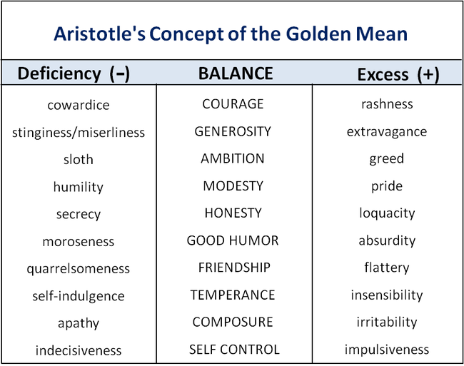
Example: athlete (ambition)

Slide 13
Virtue Ethics Though Experiment
Woman being mugged

Slide 14
Virtue Ethics
Pros and cons?

Slide 15
Summary
Utilitarianism argues that a good action is one that creates the greatest amount of pleasure and least amount of pain for the greatest number of people.
Kantianism argues that a good action is one that is dutiful and treats people as means in themselves.
Virtue ethics argues that a good action is one done virtuously, and if we develop virtuous characters, then we will lead good and moral lives.

